Slide 1
Processing 100 Million Row CSV In Node JS

Slide 2
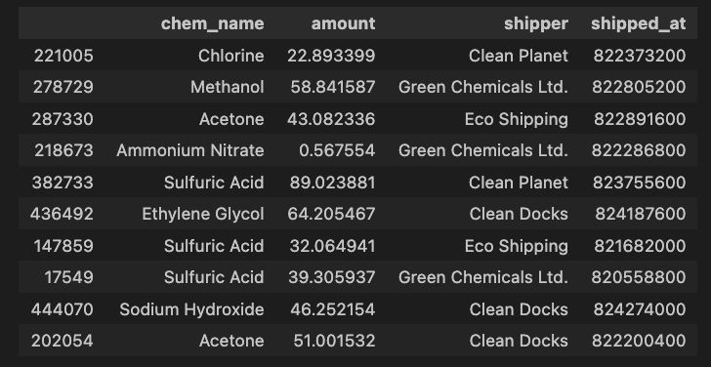

Slide 3
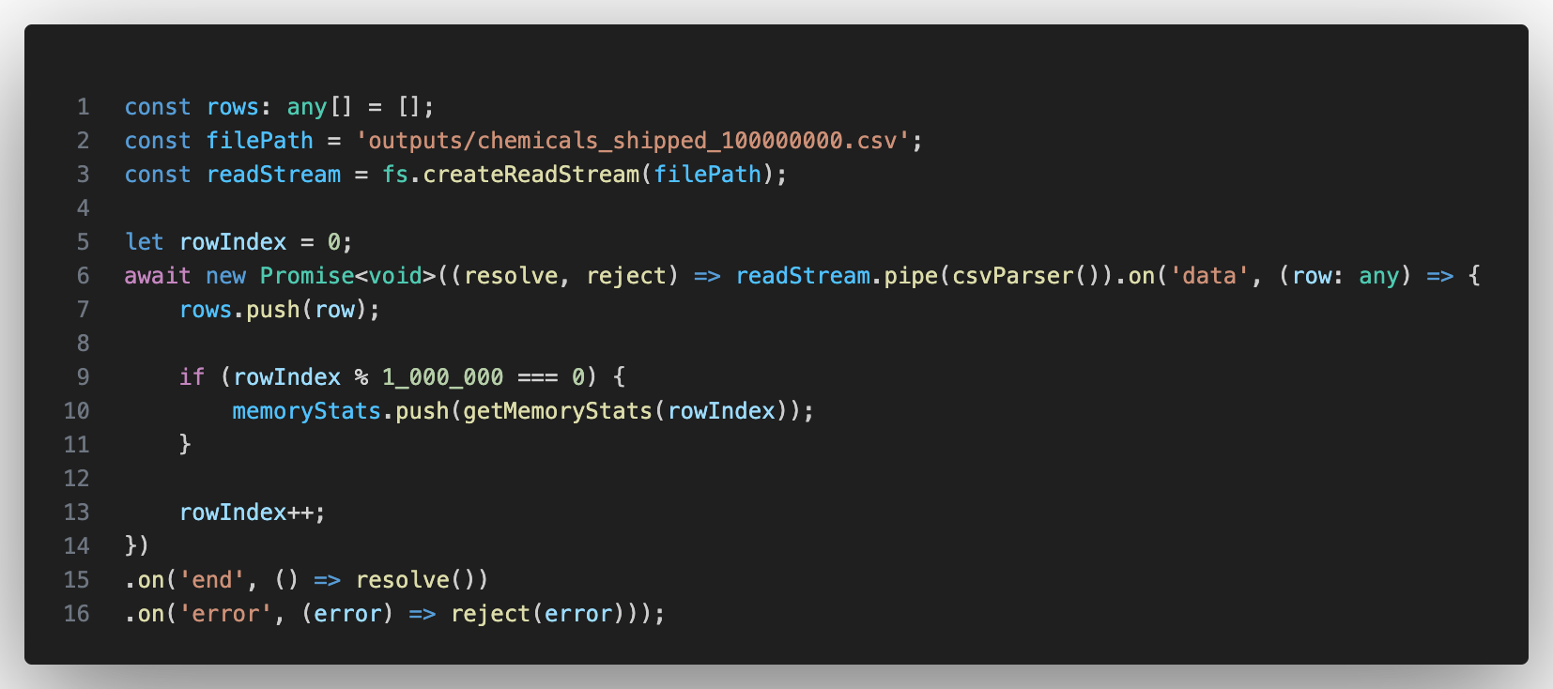

Slide 4
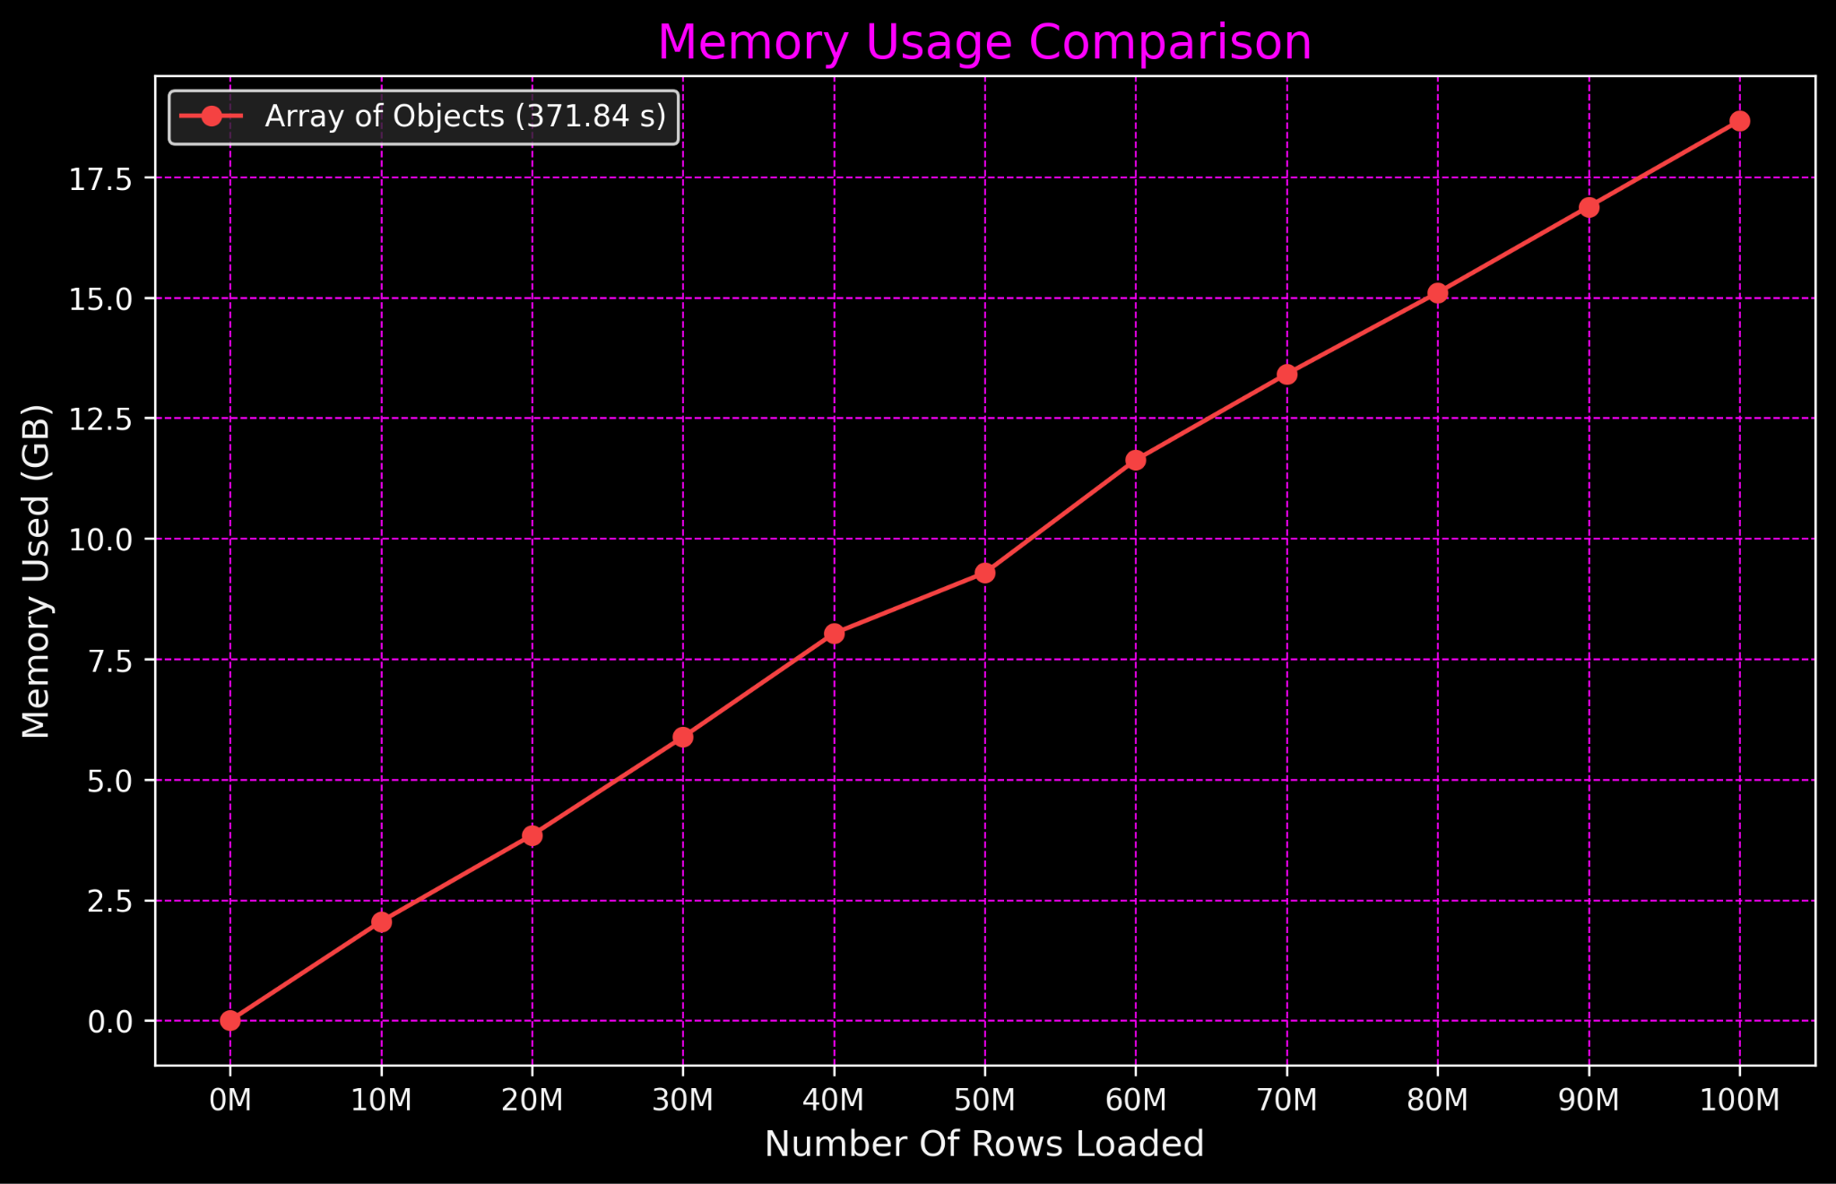

Slide 5
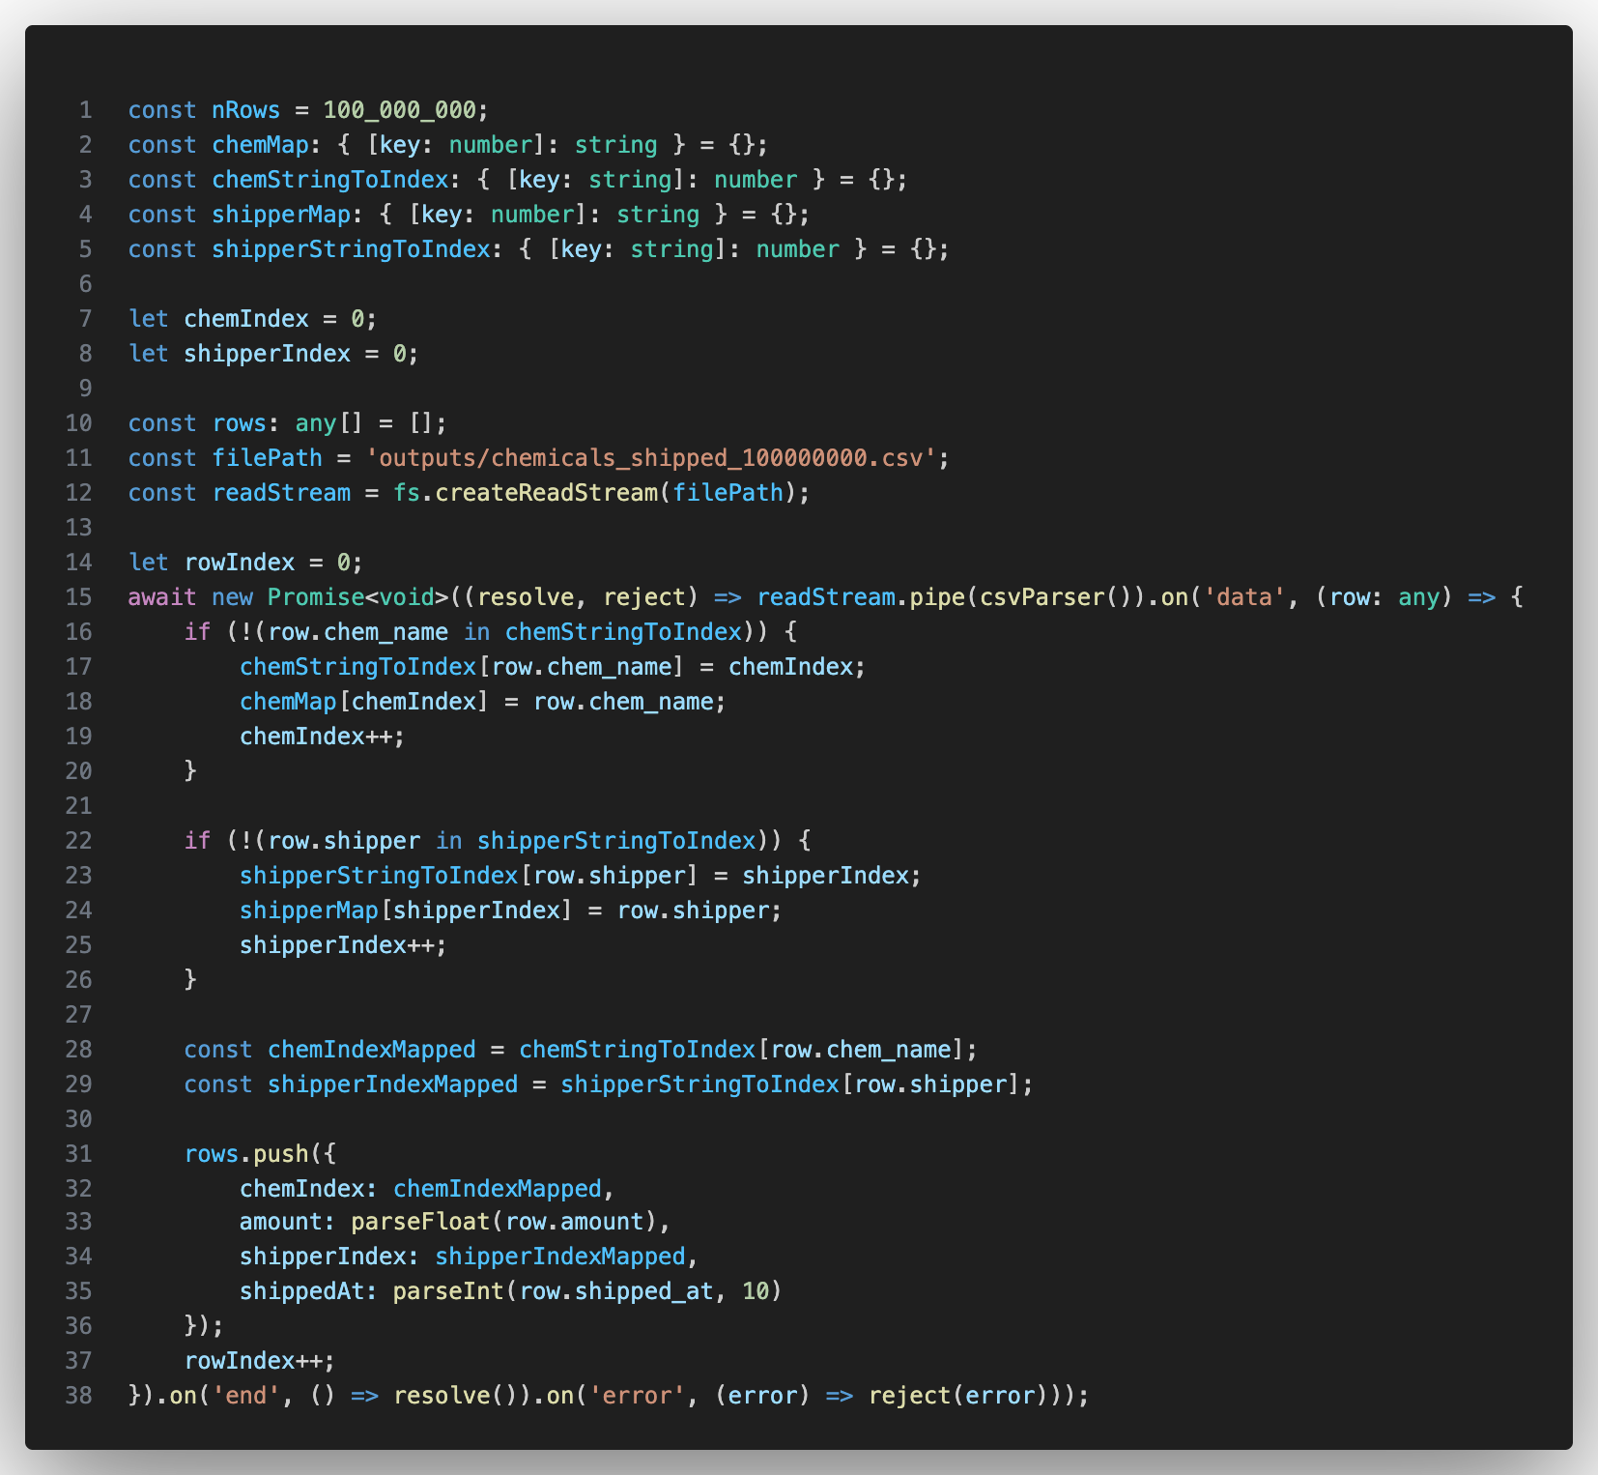

Slide 6
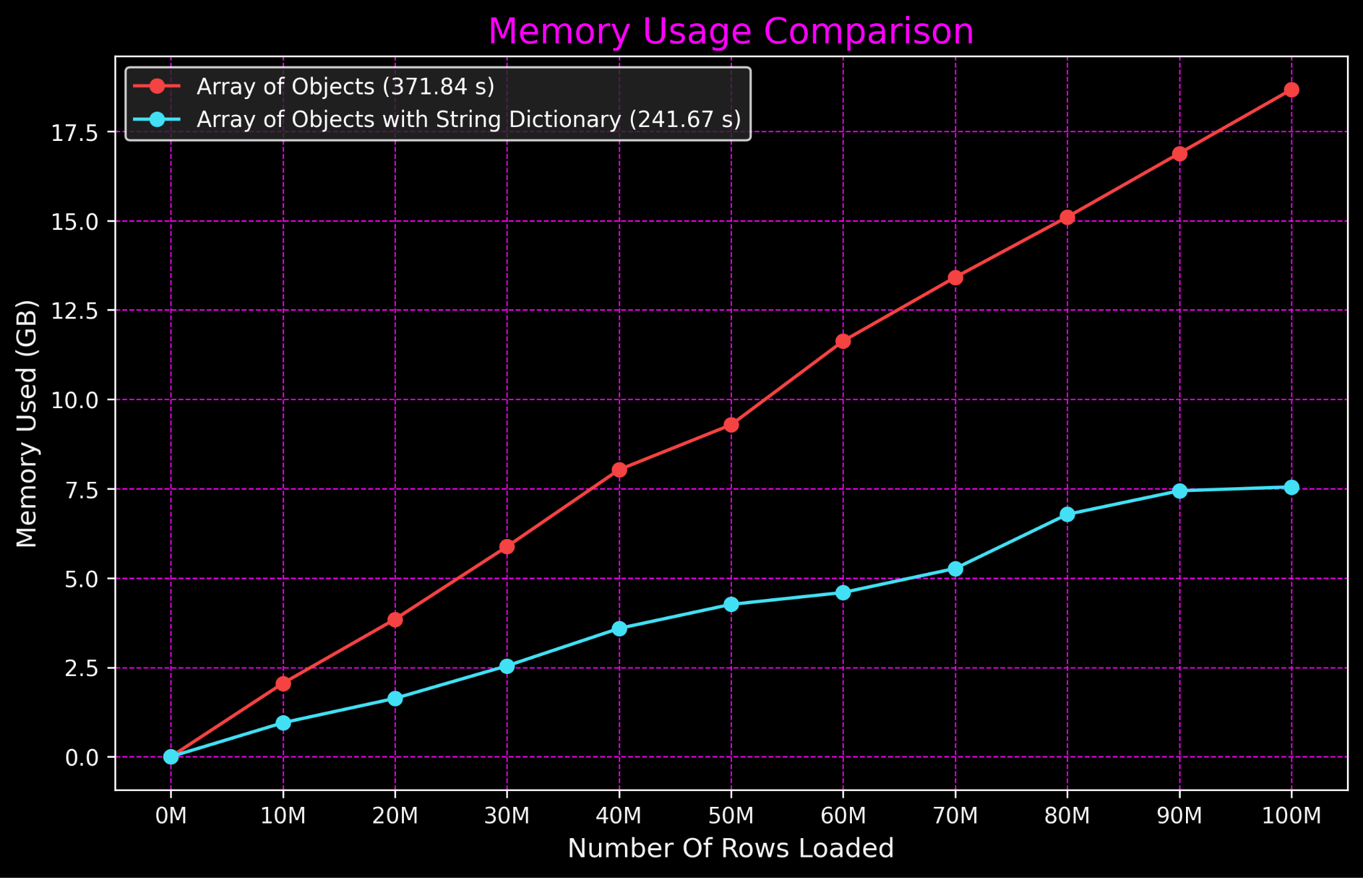

Slide 7
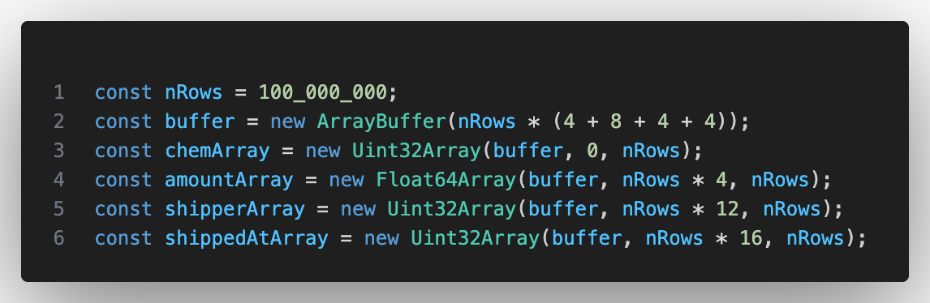

Slide 8
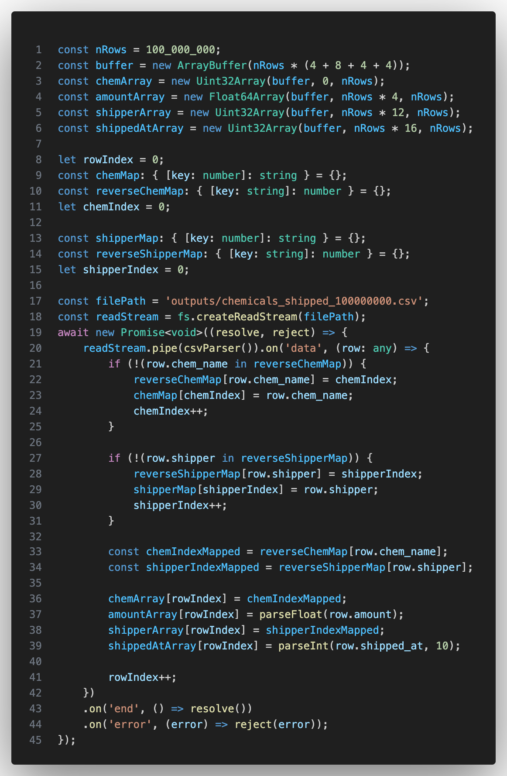

Slide 9
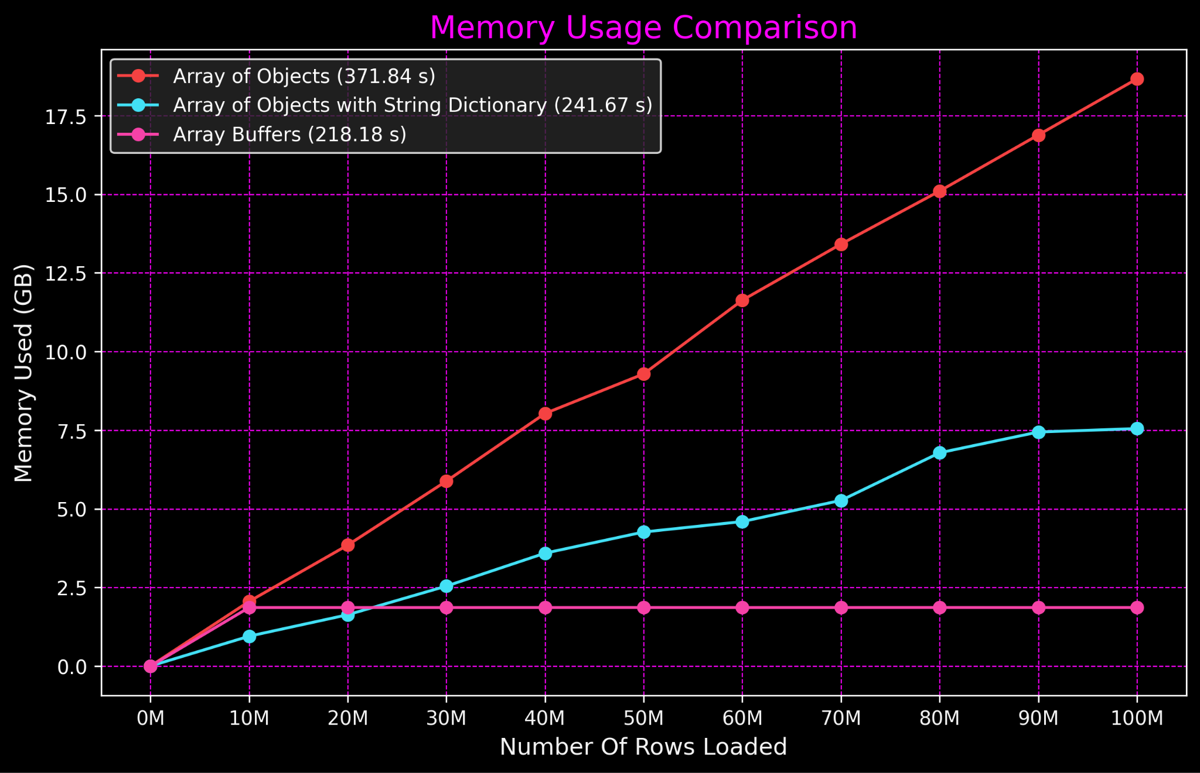

Slide 10
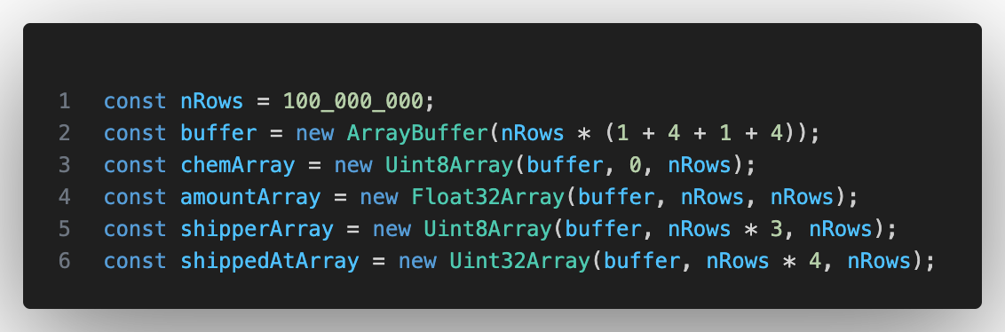

Slide 11
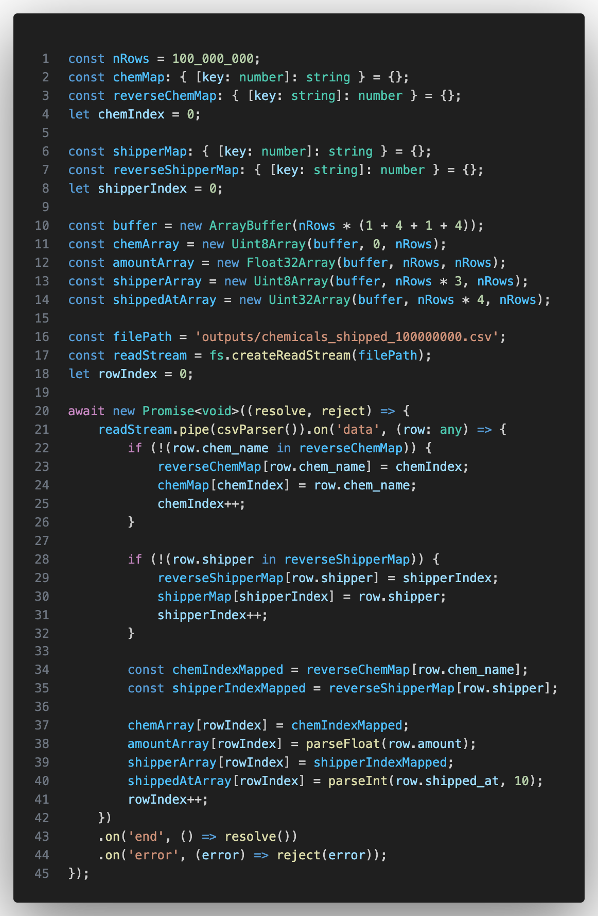

Slide 12
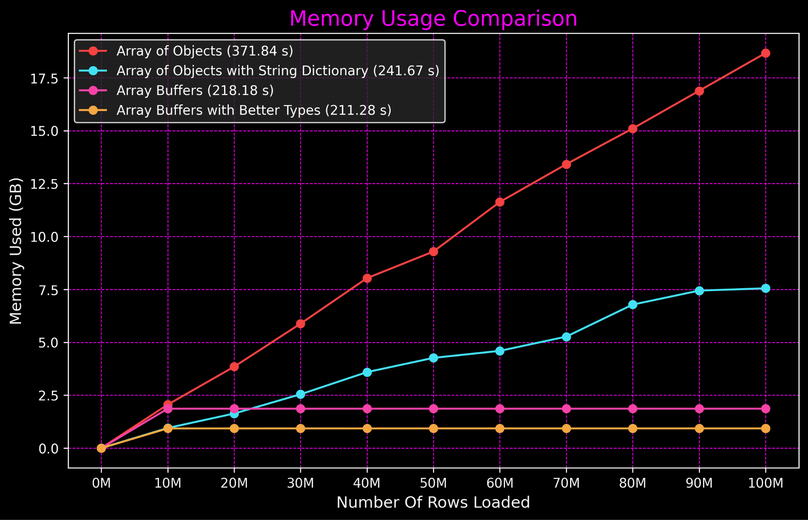

Slide 13
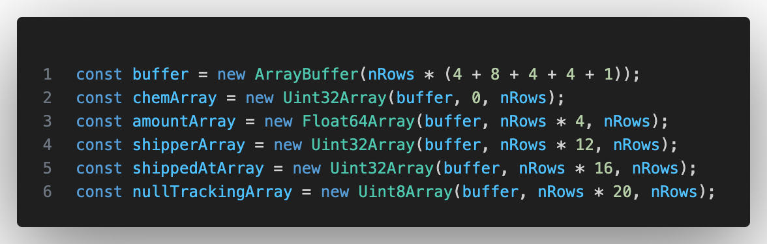

Slide 14
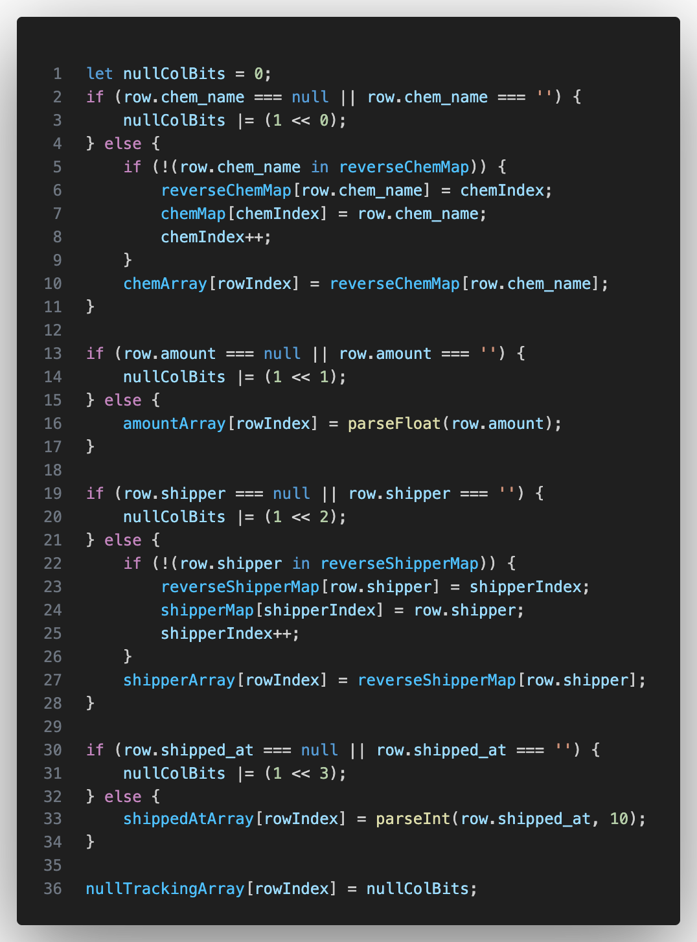
00000001 = chem_name is null
00000010 = amount is null
00001010 = amount and shipped_at are null

Slide 15
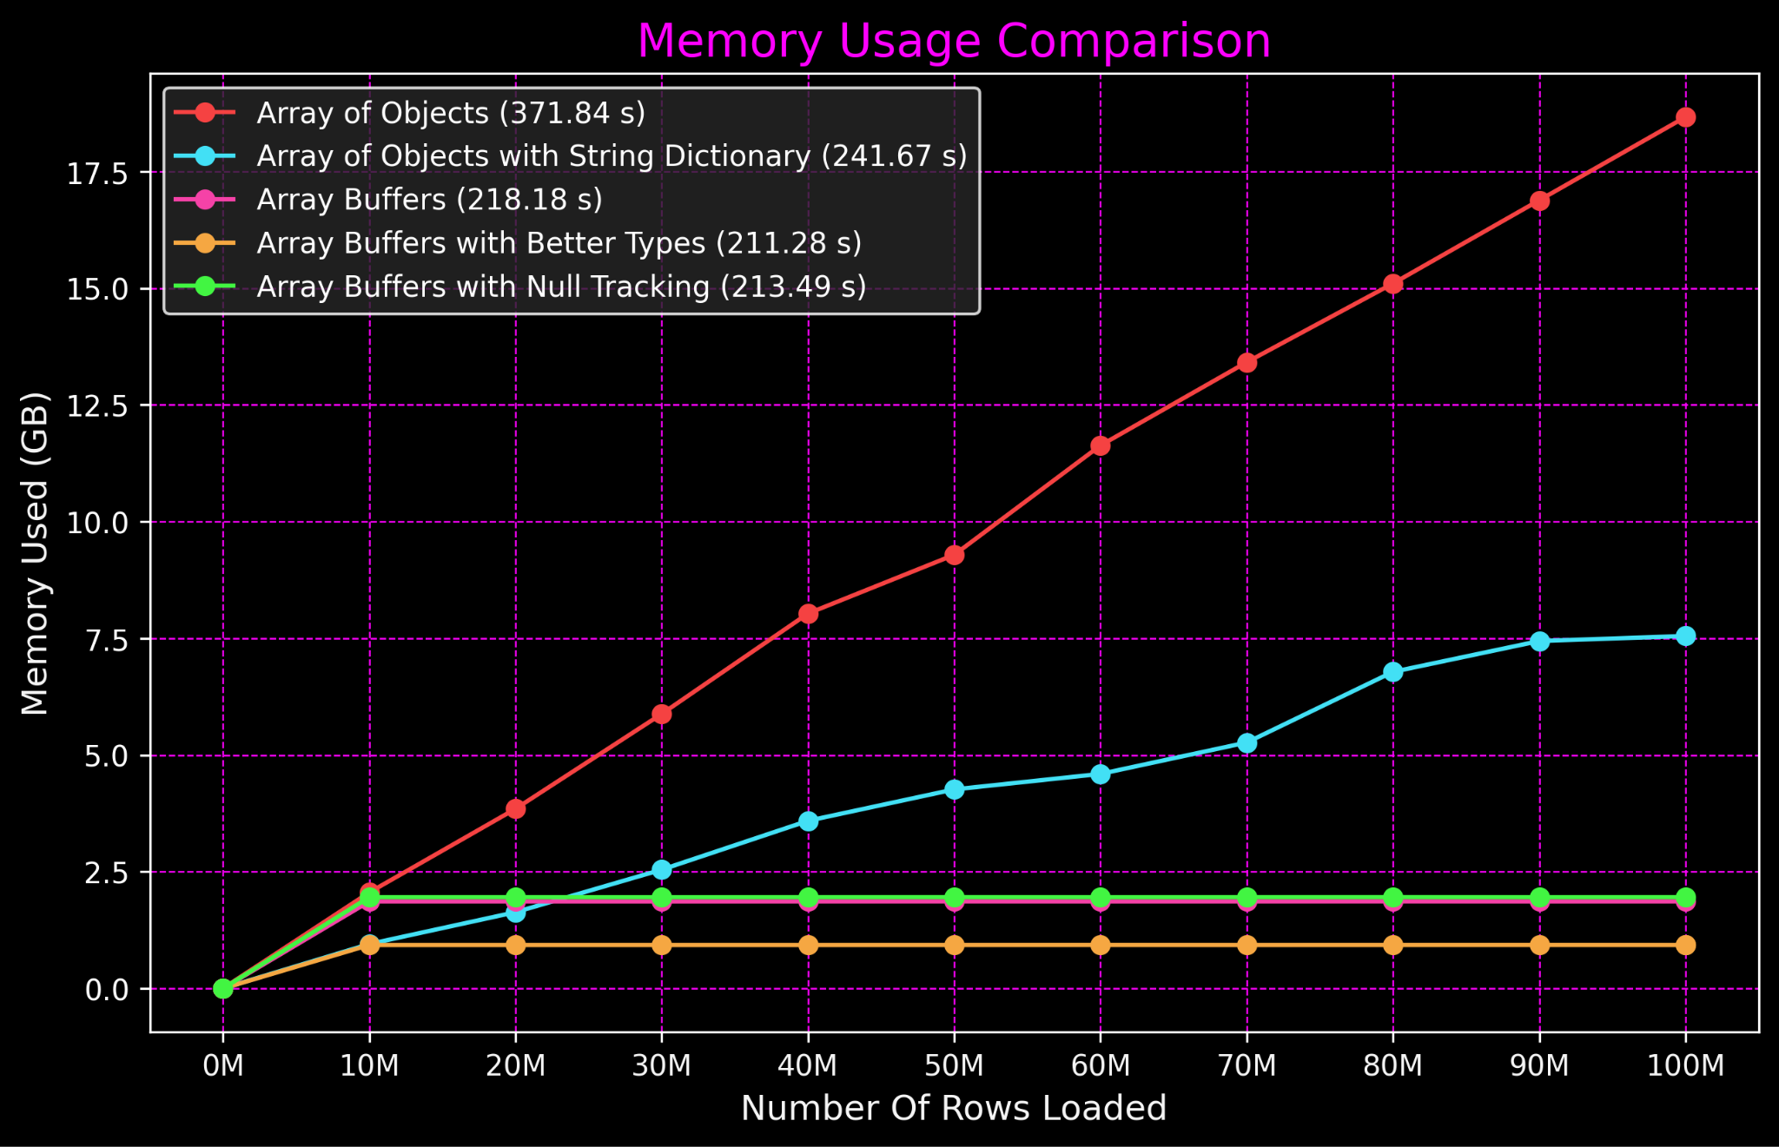

Slide 16
Apache Arrow Columnar Format
Language agnostic format
Standardization for representing tabular data in memory for efficiency and speed
Wide range of data types and null handling support
Eliminates SERDE between systems using the standard
How to represent nulls, string dictionaries, RLE etc…
Fast
SIMD optimized
GPU optimized

Slide 17
Arrow & The NodeJS
Apache Arrow JS
Only gives you the primitives
Good for building a framework on
Low adoption in JS/NodeJS community
NodeJS Polars. Frontend for Rust Polars
Best option for working with large datasets in NodeJS
Low adoption in JS/NodeJS community
Framework is not battle tested

Slide 18
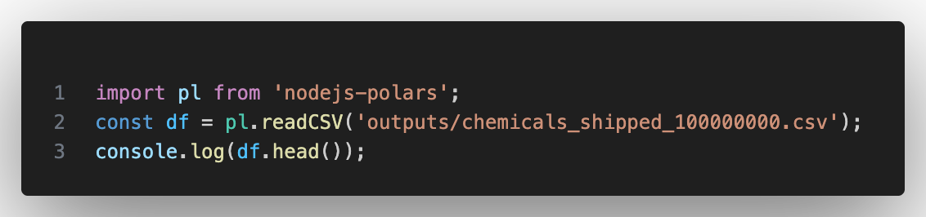
Memory Usage: 6GB
Duration: 11 seconds

Slide 19
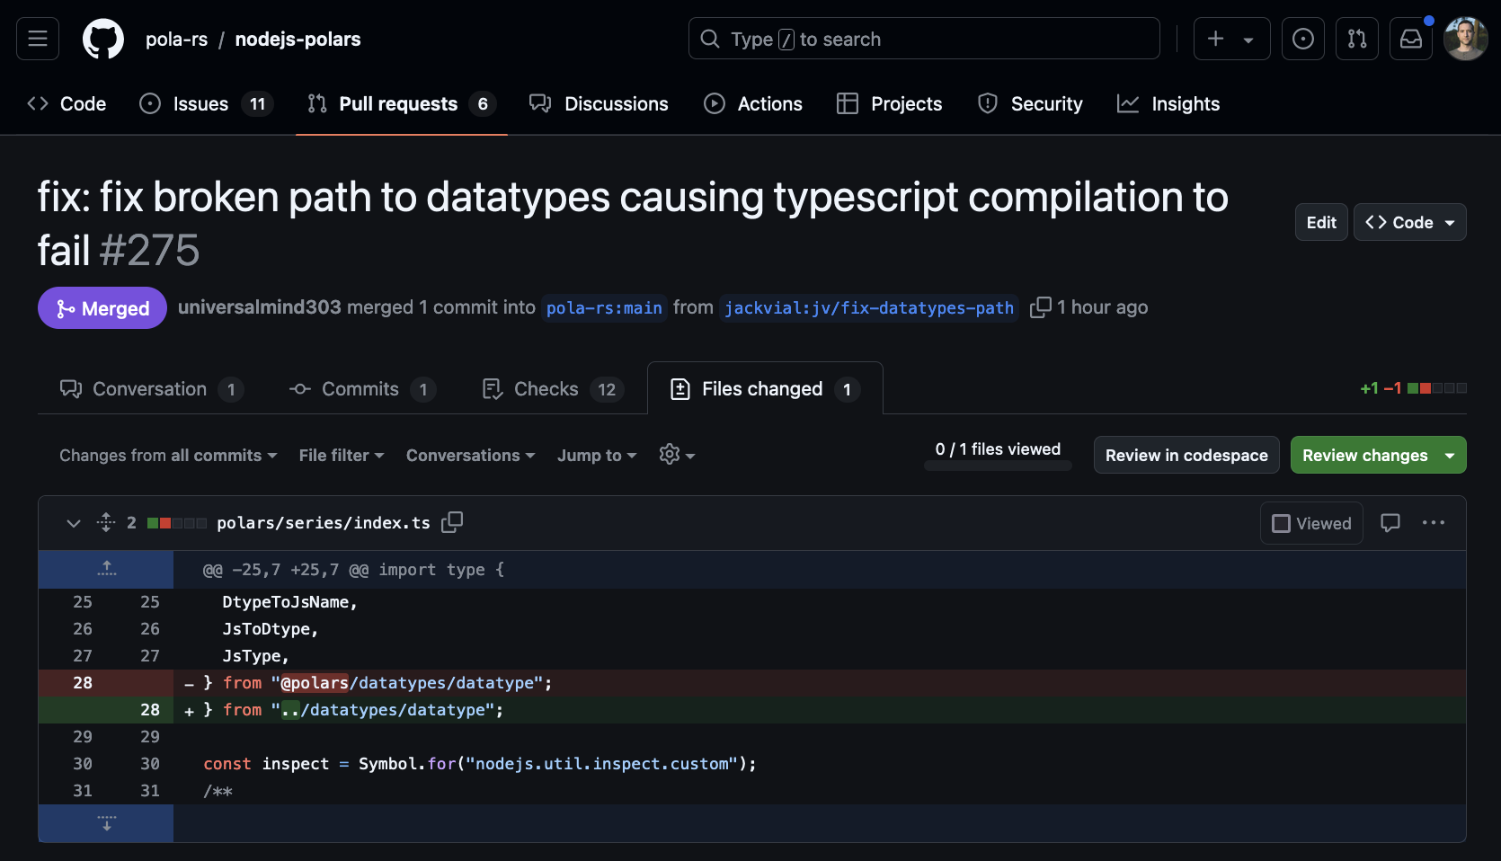

Slide 20
Arrow & Python
High adoption in python community
Used in Pandas, PyArrow, Nvidia CuDF, Pytorch, HuggingFace, Spark
Arrow Flight data transport protocol
transFlightFlightSQL ad Arrow FlightSQL and Arrow Flig

Slide 21
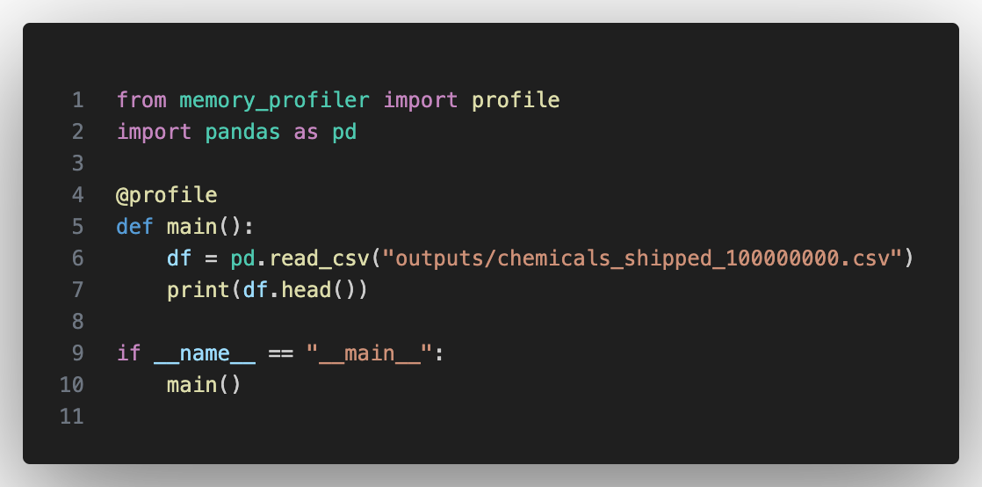
Memory Usage: 3GB
Duration: 45 seconds

Slide 22
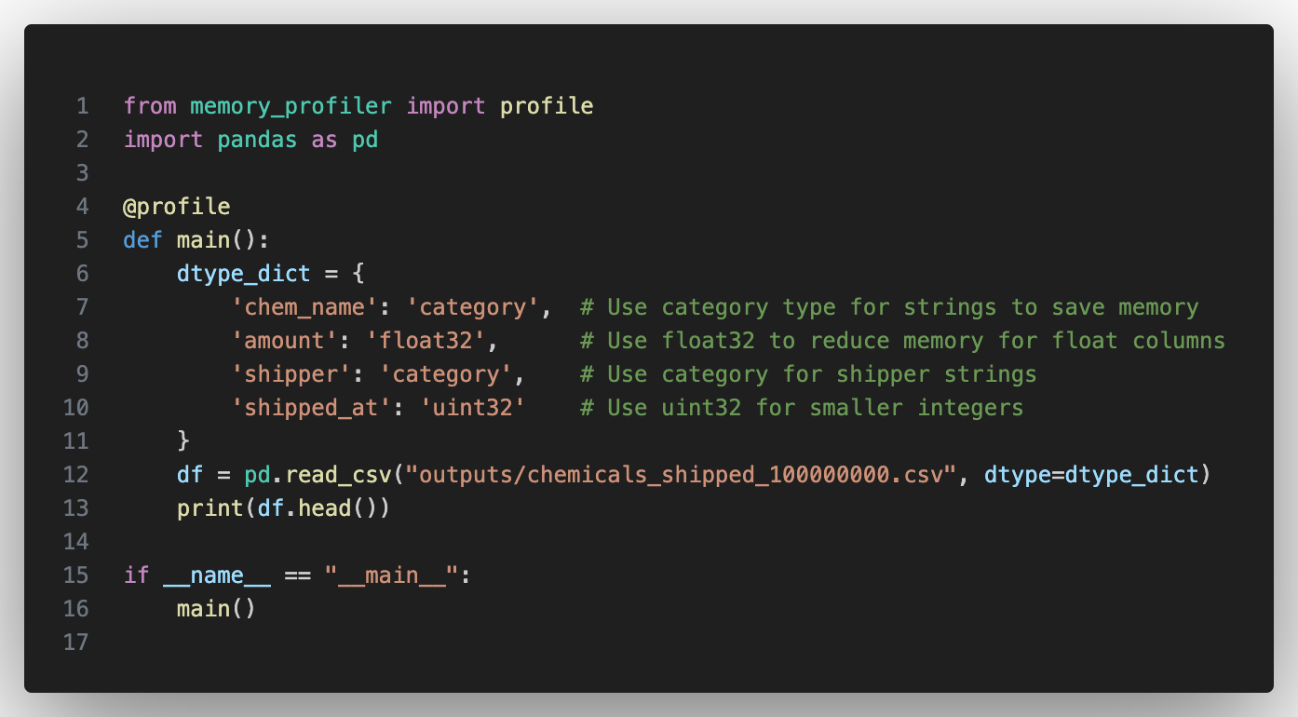
Memory Usage: 1.5GB
Duration: 48 seconds

Slide 23
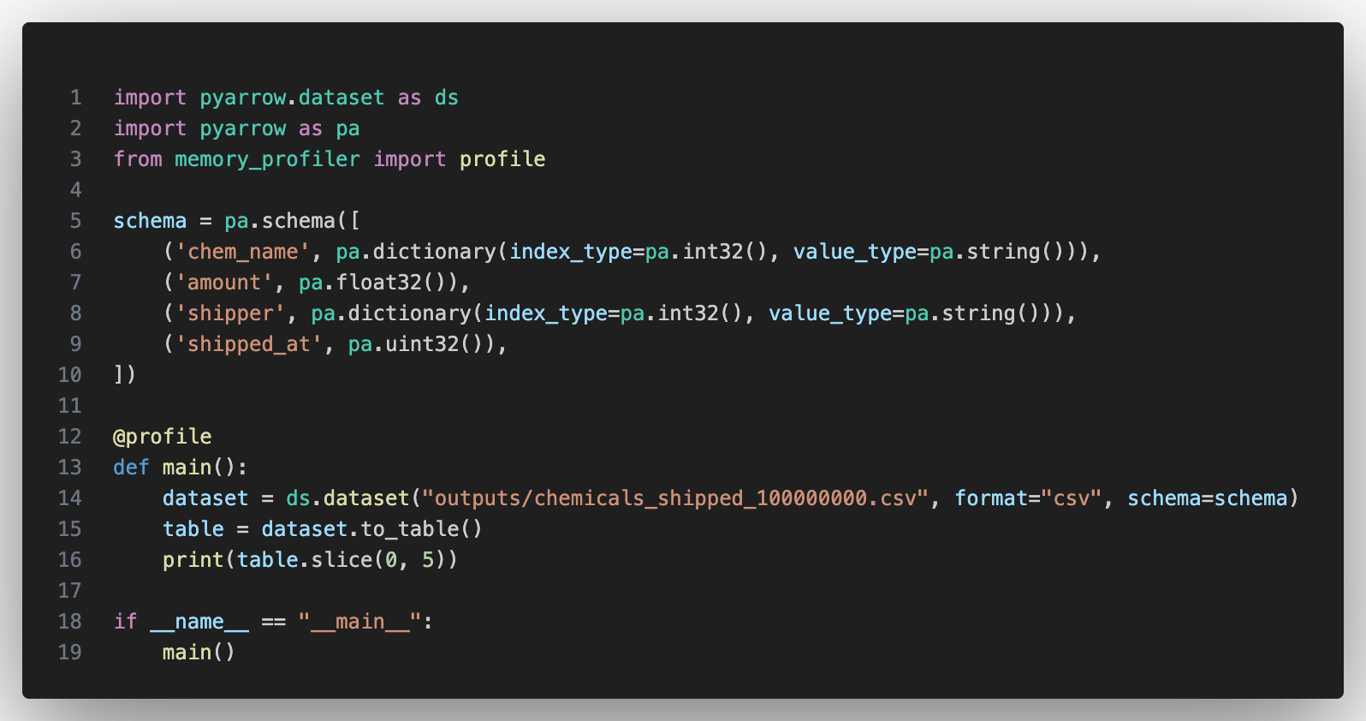
Memory Usage: 2GB
Duration: 19 seconds

Slide 24
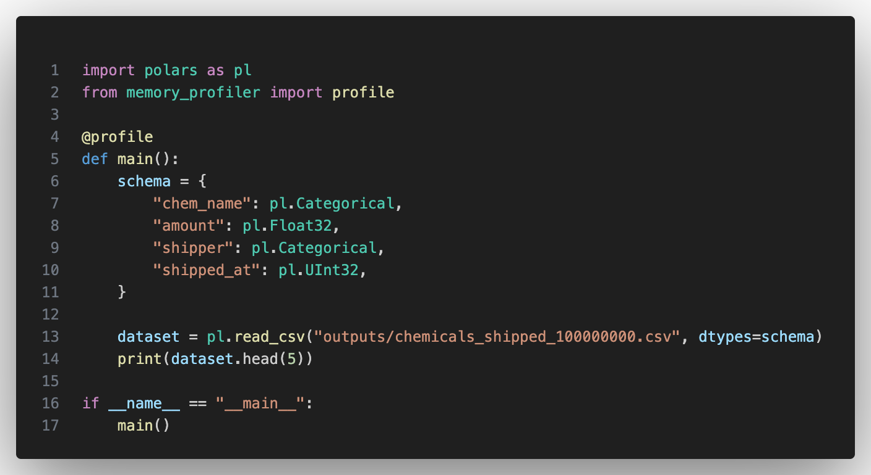
Memory Usage: 1.5GB
Duration: 3 seconds

Slide 25
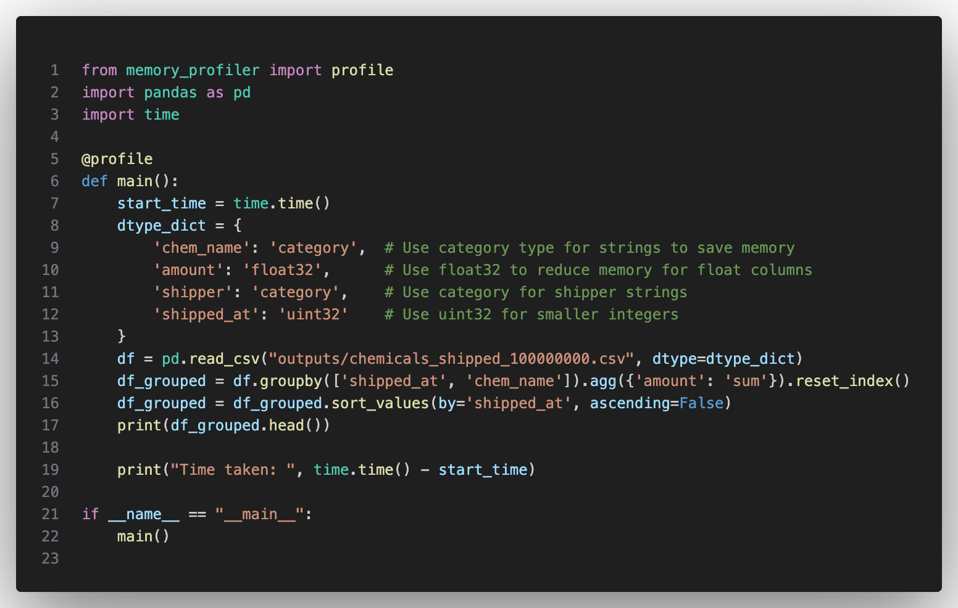
Memory Usage: 1.5GB
Duration: 50 seconds

Slide 26
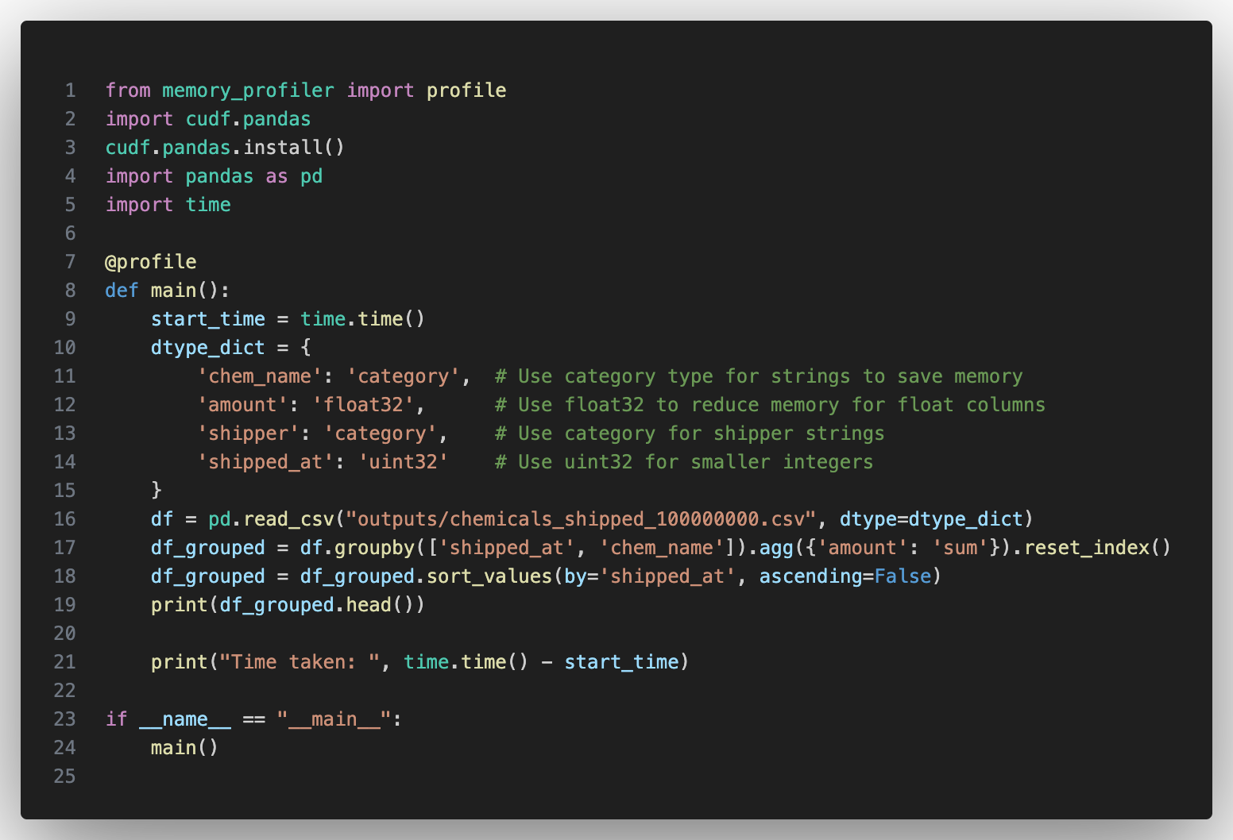
Host Memory: 0.7GB
GPU Memory: 1.6 GB
Duration: 3.2 seconds

Slide 27
In Summary
JS Array Buffer and Typed Arrays can reduce your memory usage by 10x
process.memoryUsage() is your friend
JS has everything needed to build fast data processing tools, typed arrays, shares array buffer, worker threads, atomics. But under utilized by community
JS data loading could be made much faster with better stream transformer implementation
Node JS Polars is the best option for Node JS (Rust frontend)
DataFrame libraries are powerful abstractions that encapsulate in memory storage, IO, and common operations like sort, group by, aggregation, joins etc…
Arrow Columnar Format has been widely adopted in Python, C++, Rust and is making headway in other languages
Pandas, PyArrow, Polars, CuDF, Parquet
Python ecosystem is a lot more mature for big data processing

